Slide 1

AIRLINE RESERVATION DATABASE
Submitted By : Shantanu Deosthale
INFO 6210 - 001851612

Slide 2
Contents :
Introduction
Entities & their relevant attributes
Entity list
Primary Keys & Foreign Keys
Triggers And Stored Procedure implementations:
Cardinality
Final EER Diagram
Screen Shots

Slide 3
Introduction
Airlines Ticketing provides with a larger scope for database design, nowadays flying has become necessity rather than a luxury so in order to maintain its high reliability, safety records and highly gained trusts from customers, airlines have more transactions, causing day to day expanding business activities hard to manage its operations. To ensure more flexible service for customers, it’s highly recommended to implement and Airlines Reservation System, a computerized system that will help manage all information related to flight, passengers, their contact details, reservation, transactions, schedule publishing, air fare payments etc.

Slide 4
Entity List
Aircrafts
Route
Airfare
Flight_Schedule
Passengers
Contact_Details
AirlineCharges
AirlplanesDiscounts
Employee
Transaction
TransactionProfile

Slide 5
Table | Primary Keys | Columns/Table | Reference
Aircrafts | AcID | - | -
Flight_Schedule | FlID | Aircrafts Airfare | AcID AfID
Airfare | AfID | Route | RtID
Route | RtID | - | -
Charges | ChID | - | -
Discounts | DiID | - | -
Passengers | PsID | - | -
Contact_Details | CnID | Passengers | PsID
Employee | EmpID | - | -
Transactions | TsID | Flight_Schedule Charges Discounts Passengers Employee | FlID ChID DiID PsID EmpID
TransactionProfile | - | Transactions | TsID

Slide 6
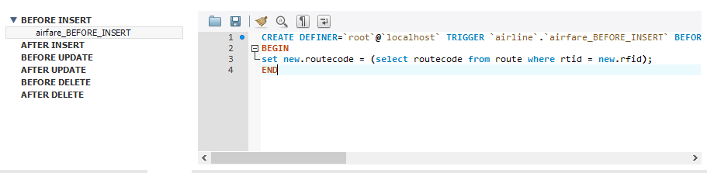
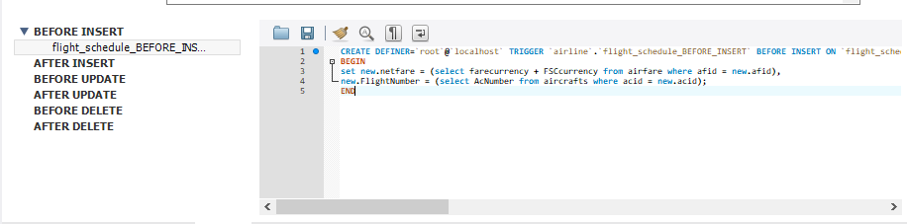
Triggers Implementation

Slide 7
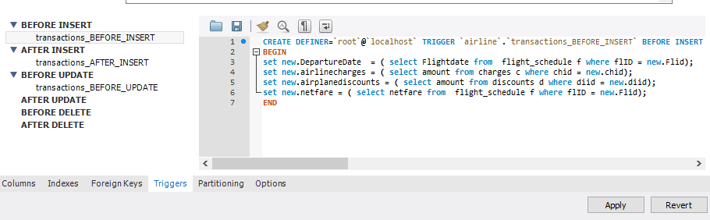
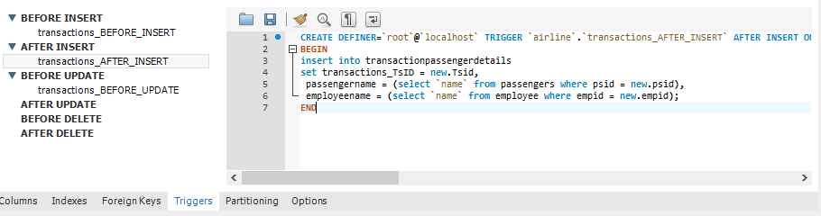
Triggers Implementation

Slide 8
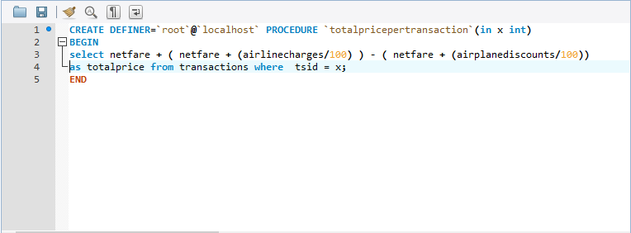
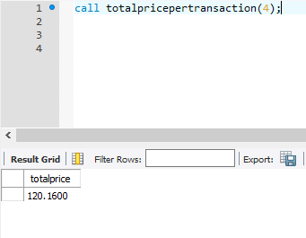
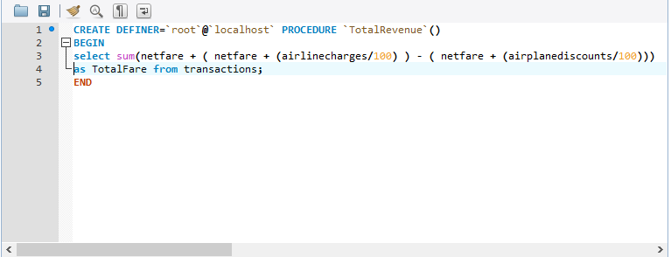
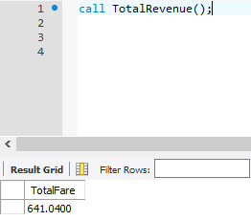
Store Procedure Implementation

Slide 9
Sno. | Entities | Cardinality
1. | Aircrafts & Flight_Schedule | 1:M
2. | Route & Airfare | 1:1
3. | Airfare & Flight_Schedule | 1:M
4. | Discounts & Transactions | M:1
5. | Charges & Transactions | M:1
6. | Passengers & Contact_Details | 1:1
7. | Passengers & Transactions | 1:1
8. | Employee & Transactions | 1:M
9. | Transactions & Flight_Schedule | M:1
10. | Transactions & TransactionProfile | 1:1

Slide 10
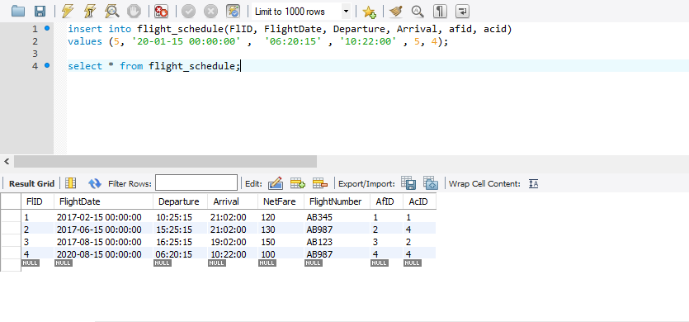
Screen Shots

Slide 11
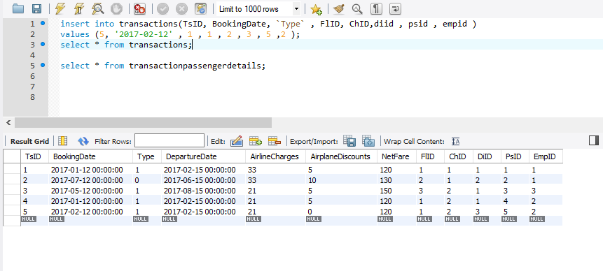
Screen Shots

Slide 12
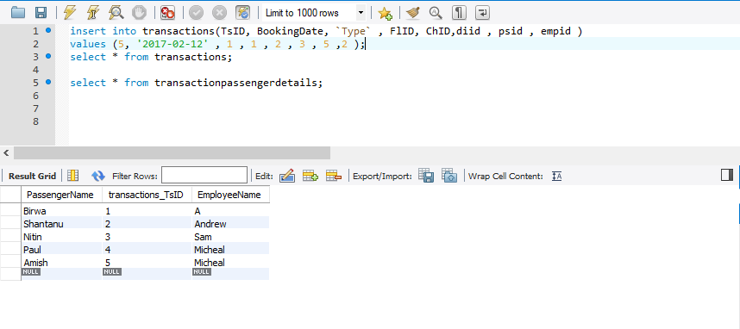
Screen Shots

Slide 13
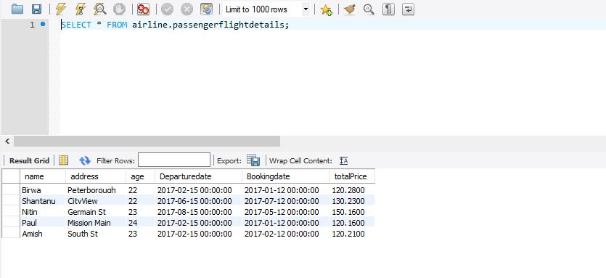
View To Show Passenger Flight Details

Slide 14
